Slide 1
FEELINGS AND EMOJIS

Slide 2

SAD

Slide 3

HAPPY
Notes:
HAPPY

Slide 4

ANGRY

Slide 5

SLEEPY

Slide 6
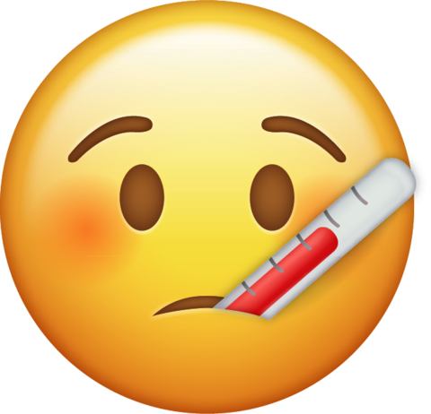
SICK

Slide 7

IN LOVE

Slide 8

SCARED

Slide 9

RELAXED

Slide 10

NERVOUS

Slide 11

TIRED

